Slide 1
Introduction to Shakespeare’s Hamlet
ELA B30

Slide 2
Elements of a tragedy

Slide 3
Comic Relief
Tragic Hero
Internal Conflict
Hamartia
External Conflict
Lack of Poetic Justice
Supernatural Elements
Catharsis
A struggle between good and evil

Slide 4
Characters

Slide 5
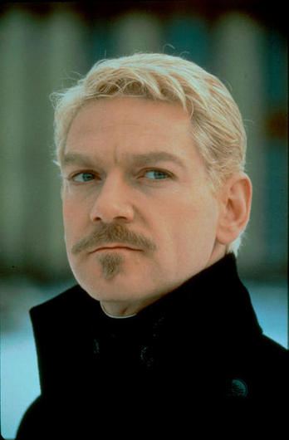
Hamlet
Prince of Denmark
Student at the University of Wittenberg
Son of the late King Hamlet and Queen Gertrude

Slide 6
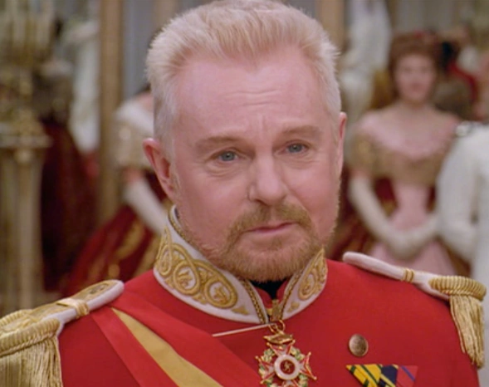
Claudius
King of Denmark
Uncle of Hamlet
Recently married to Gertrude

Slide 7
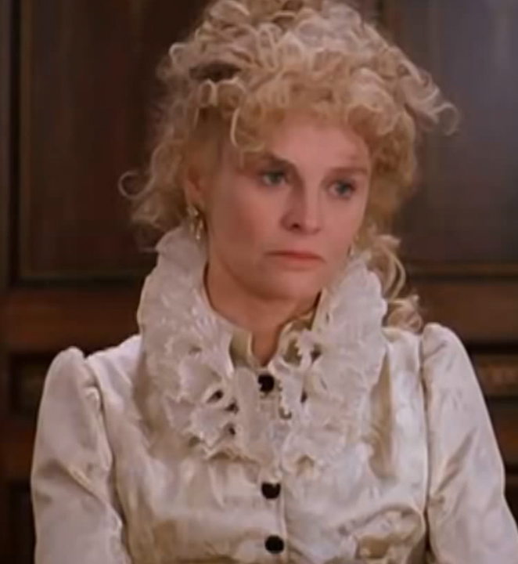
Gertrude
Queen of Denmark
Mother of Hamlet
Recently married to Claudius

Slide 8
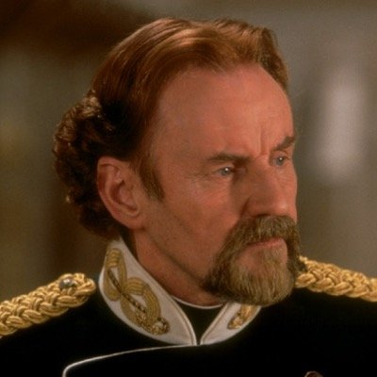
Polonius
The Lord Chamberlain of Claudius’s Court
Father of Laertes and Ophelia

Slide 9
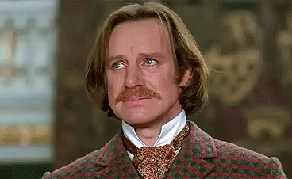
Horatio
Hamlet’s close friend
Loyal companion

Slide 10
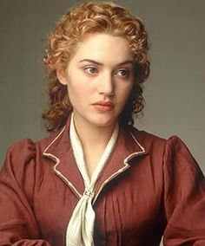
Ophelia
Polonius’ daughter
Sister of Laertes
Lover of Hamlet

Slide 11
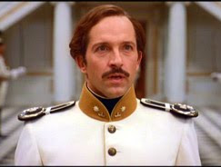
Laertes
Polonius’ son
Ophelia’s brother

Slide 12
Fortinbras
Young Prince of Norway
Father was killed by Hamlet’s father

Slide 13
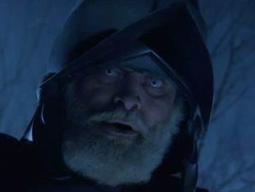
The ghost
Seeming spirit of Hamlet’s deceased father

Slide 14
Minor characters
Rosencrantz and Guildenstern: friends of Hamlet
Osric: foolish courtier
Voltimand and Cornerlius: courtiers
Marcellus and Barnardo: officers who stand guard
Francisco: Soldier and guardsman of Elsinore
Reynaldo: Polonius’ servant

Slide 15
Setting

Slide 16
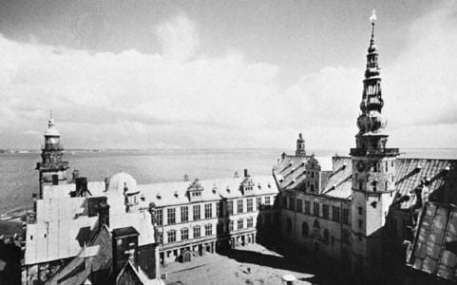
Elsinore, Denmark
Royal Palace and city Elsinore

Slide 17
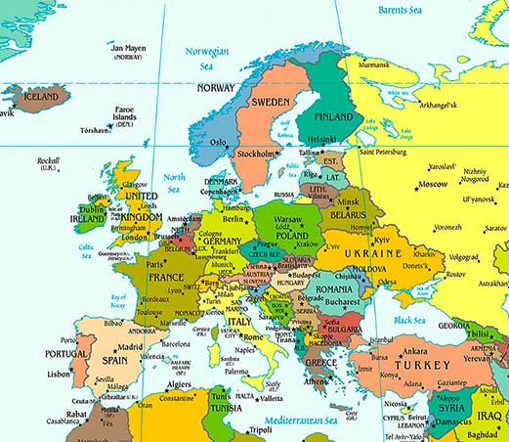

Slide 18
