Slide 1
A Modest Proposal
By Johnathan Swift in 1729

Slide 2
Brief History of Ireland
In the 1600 and 1700’s Ireland was under the control of Britain. There was a huge divide both socially and economically between the English Protestants and the Irish Catholics.
80% of the population of Ireland was Irish Catholic poor. They owned less than ⅓ of the land.
Irish Catholics were oppressed in their own country. There were rebellions against the English to try to take their lives and their land back.
Penal laws were created to suppress the Catholic religion and keep Catholics in poverty.
Catholics were not allowed to vote, hold public office, or send their children abroad to be educated in Catholicism.

Slide 3
Catholics could not leave their land to their eldest son but had to divide it up among all the male children.
Poor Irish Catholics lived as tenant farmers on the estates of rich, absentee English landlords. Almost all of their crop was used to pay their rent.
Large families lived in poorly constructed, cramped, and dirty houses. Sickness and starvation were facts of life.
There was no Employment Insurance (EI) or social assistance. When a family could no longer make a living they had no choice but to go to the workhouse or turn to begging.

Slide 4
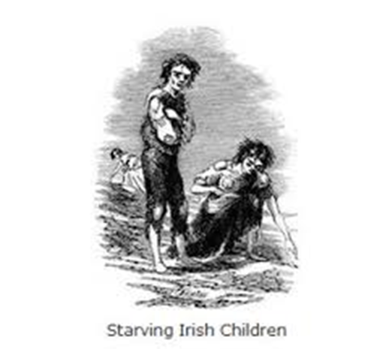
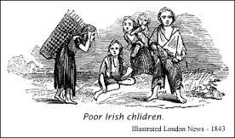
Large numbers of Irish Catholic children lived in abject poverty.
Swift composed “A Modest Proposal” in the summer of 1729 after three years of drought and famine in Ireland.
Crop failure forced more than 30 000 Irish citizens to abandon their homes in search of work, food, and shelter. (This was not the Irish Potato Famine of 1845-52).

Slide 5
Read “A Modest Proposal” By Johnathan Swift

Slide 6
“A Modest Proposal”
By Johnathan Swift
A modest proposal for preventing the children of poor people in Ireland, from being a burden on their parents or country, and for making them beneficial to the publick.

Slide 7
His proposal, in effect, is to fatten up these undernourished children and feed them to Ireland's rich land-owners.
Children of the poor could be sold into a meat market at the age of one, he argues, thus combating overpopulation and unemployment, sparing families the expense of child-bearing while providing them with a little extra income, improving the culinary experience of the wealthy, and contributing to the overall economic well-being of the nation.

Slide 8
The Problem: Extreme poverty, specifically child poverty, too many children, it costs too much for their families to feed and clothe them.
The Solution: Eat them! Breed them for food and clothing.
Advantages:
Decreases the number of Catholics (and decreases the population in general)
Poor tenants would have something of value (that they create themselves and costs nothing to make) that they can use to pay their debts.
The cost of raising these children to adulthood would be saved.
When a rich man buys a child to eat the profit circulates within the nation.
The creation of a new national dish.
Poor families gain 8 shillings per child.
Parents don’t have to worry about raising their children.
Men would love their wives more because they are bringing something of value to the family. Mothers would love their babies more because they would be worth something.
There would be more beef to export (sell to other countries for money) because locals would be eating locally.

Slide 9
The Real Solution:
Create a tax for absentee landlords.
Buy clothing, furniture and other goods that are locally made rather than spending money on foreign goods. This keeps the wealth circulating within the nation.
Reject items of foreign luxury.
Teach women not to be so proud, vain, and idle. Stop them from gambling.
Be more thrifty, careful and moderate in lifestyles and spending.
Put aside our differences and stop fighting among ourselves.
Expect landlords to have “at least one degree of mercy towards their tenants.”
Taking on a spirit of honesty and industry. Stop trying to scalp each other to make a profit at any expense.

Slide 10
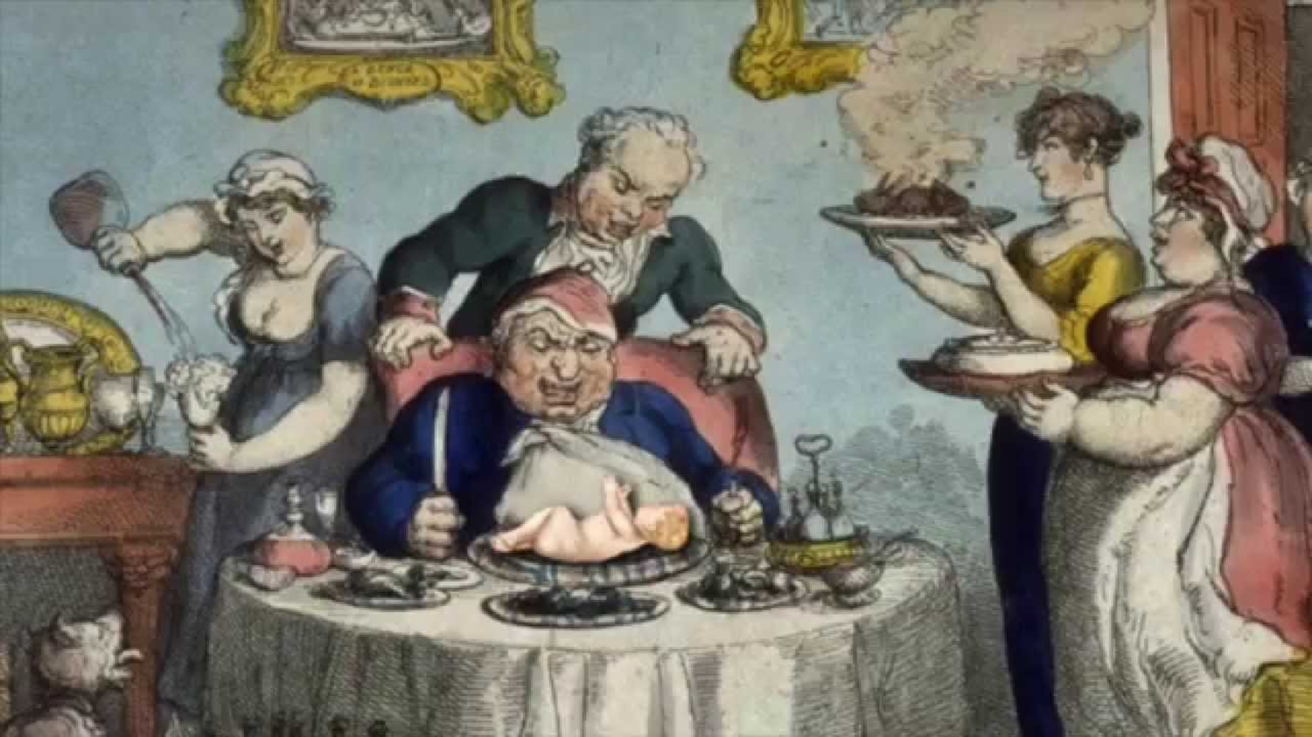

Slide 11
Satire, Parody and Irony

Slide 12
SATIRE
“The use of humour, irony, exaggeration, or ridicule to expose and criticize people's stupidity or vices, particularly in the context of contemporary politics and other topical issues.”

Slide 13
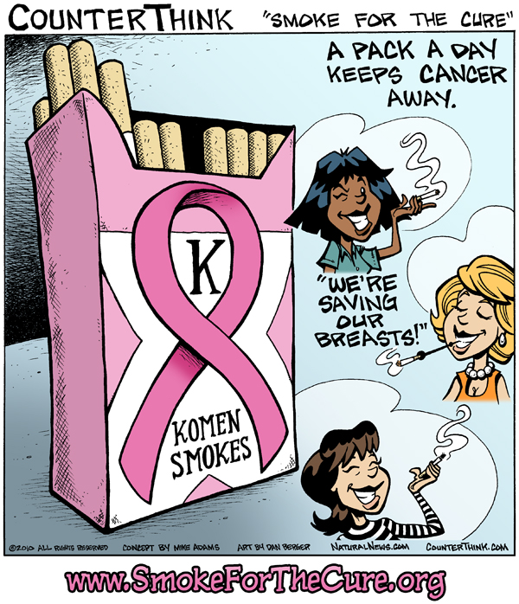

Slide 14
Examples:
Family Guy: https://www.youtube.com/watch?v=HBkvgdv-000
SNL Voters for Trump: https://www.youtube.com/watch?v=Qg0pO9VG1J8
SNL Guns: https://www.youtube.com/watch?v=SwEyBItsXkw
Modern Educayshun:
https://www.youtube.com/watch?v=iKcWu0tsiZM
SNL This not a feminist song: https://www.youtube.com/watch?v=YfiLAcERNQ4
Jimmy Fallon Hashtag: https://www.youtube.com/watch?v=57dzaMaouXA&index=3&list=PLF4GZVuVOAhIpPlYfOUpGZU9Jodv8_uDk

Slide 15
PARODY
“An imitation of the style of a particular writer, artist, or genre with deliberate exaggeration for comic effect.”
Copy-Cat for humor

Slide 17
I’ll kill you that way (Backstreet Boys Parody) : https://www.youtube.com/watch?v=oliCVn7Ic68

Slide 19
IRONY
“The expression of one's meaning by using language that normally signifies the opposite, typically for humorous or emphatic.”

Slide 21
