Slide 1
MLA Format

Slide 2
Basic Rules for MLA
At the beginning of your paper, the following should be placed on the left hand side at the top of the page:
Name
Teacher/Prof
Class/Course
Date
And your last name followed by the page number should be in the top right hand corner of every page

Slide 3
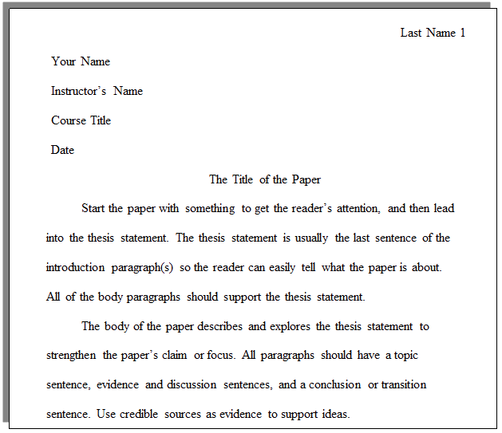

Slide 4
In-Text Citation
Wordsworth stated that Romantic poetry was marked by a "spontaneous overflow of powerful feelings" (263).
Romantic poetry is characterized by the "spontaneous overflow of powerful feelings" (Wordsworth 263).
Wordsworth extensively explored the role of emotion in the creative process (263).

Slide 5
When a source has no known author, use a shortened title of the work instead of an author name. Place the title in quotation marks if it's a short work (such as an article) or italicize it if it's a longer work (e.g. plays, books, television shows, entire Web sites) and provide a page number if it is available.
We see so many global warming hotspots in North America likely because this region has "more readily accessible climatic data and more comprehensive programs to monitor and study environmental change . . ." ("Impact of Global Warming").

Slide 6
Block Quotations
Place quotations four or more typed lines in a free-standing block of typewritten lines, and omit quotation marks.
Start the quotation on a new line, indented one inch from the left margin, and maintain double-spacing.
Your parenthetical citation should come after the closing punctuation mark.

Slide 7
It is not until near the end of The Hound of the Baskervilles that the hound itself is actually seen:
A hound it was, an enormous coal-black hound, but not such a hound as mortal eyes have ever seen. Fire burst from its open mouth, its eyes glowed with a smouldering glare, its muzzle and hackles and dewlap were outlined in flickering flame. Never in the delirious dream of a disordered brain could anything more savage, more appalling, more hellish be conceived than that dark form and savage face which broke upon us out of the wall of fog. (Doyle 82)

Slide 8
WORKS CITED

Slide 9
What does it look like?
Said, Edward W. Culture and Imperialism. Knopf, 1994.
Author
Last name, First name.
Title
Must be italicised or in quotation marks depending on the type of text
Publisher
Publisher Company, Year of
Publication

Slide 10
Adiche, Chimamanda Ngozi. “On Monday of Last Week.” The Thing around Your Neck, Alfred A. Knopf, 2009, pp. 74 - 94.
Page numbers should be included when you are using part of a work (not the whole thing).
Page numbers would be used if you only used a small portion of the book or just a chapter.

Slide 11
Online Source
Bernstein, Mark. "10 Tips on Writing the Living Web." A List Apart: For People Who Make Websites, 16 Aug. 2002, alistapart.com/article/writeliving. Accessed 4 May 2009.

Slide 12
When do I italicise a title? When do I underline a title? When do I use quotation marks in a title?

Slide 13
Italics and Underline
These are used when it is a larger work that you are quoting/citing. When you are TYPING, always ITALICISE. When you are HANDWRITING, always UNDERLINE.
These include, but are not limited to:
Novels
Plays
Movies
Magazines
Journals

Slide 14
“Quotation Marks”
These should be used for smaller work titles - texts that cannot stand on their own (usually part of a bigger collection).
These include, but are not limited to:
Poems
Short Stories
Articles
Songs

Slide 15
Here’s a trick to help you remember:
If it is a book or a movie (or any bigger work, it should be able to stand on its own so it gets put on a shelf - which means it gets underlined (same as italicised).
If it has a SPINE, it gets UNDERLINED
If it cannot stand on its own (smaller works) - it needs to be pinned up so think of quotation marks as pins for each top corner of the paper.
Just like every trick or rule, there are exceptions, but generally this works!

Slide 16
Quotation Marks
Underlined or Italicised

Slide 17
Works Cited Page
Your works cited page MUST be on a separate page at the end of your essay
Your title should always be “Works Cited” and centred at the top of the page
Your page should be organized in alphabetical order by their last names
Double space all citations, but do not add extra spaces between entries

Slide 18
Works Cited
Dean, Cornelia. "Executive on a Mission: Saving the Planet." The New York Times, 22 May 2007, www.nytimes.com/2007/05/22/science/earth/22ander.html?_r=0. Accessed 12 May 2016.
Gowdy, John. "Avoiding Self-organized Extinction: Toward a Co-evolutionary Economics of Sustainability." International Journal of Sustainable Development and World Ecology, vol. 14, no. 1, 2007, pp. 27-36.
An Inconvenient Truth. Directed by Davis Guggenheim, performances by Al Gore and Billy West, Paramount, 2006.
Leroux, Marcel. Global Warming: Myth or Reality?: The Erring Ways of Climatology. Springer, 2005.
Milken, Michael, et al. "On Global Warming and Financial Imbalances." New Perspectives Quarterly, vol. 23, no. 4, 2006, p. 63.
Nordhaus, William D. "After Kyoto: Alternative Mechanisms to Control Global Warming." American Economic Review, vol. 96, no. 2, 2006, pp. 31-34.

Slide 19
Purdue Owl - Awesome Resource for MLA Format:
https://owl.purdue.edu/owl/research_and_citation/mla_style/mla_formatting_and_style_guide/mla_formatting_and_style_guide.html

Slide 20
Let’s Test your Knowledge

Slide 21
Martínez, Alicia. “5 Reasons to Start Composting.” Green Living. 12 Sep. 2009. Web. 04 Jan 2013.
Which statement is INCORRECT?
a) The author is Alicia Martínez.
b) Whoever wrote this citation visited the website on January 4, 2013.
c) The website title is “5 Reasons to Start Composting.”

Slide 22
What is one rule you must follow on your Works Cited Page?

Slide 23
In the proper order, what are the four things that you need in the left hand on the front page of your essay?

Slide 24
What goes in front of the page number on every page?

Slide 25
If I wanted to cite The Hunger Games, what should I do to the title?

Slide 26
FOLLOW THESE RULES FOR THE REST OF YOUR LIFE (unless they get updated - then follow that) TO AVOID PLAGIARISM AND CRUSHING YOUR FUTURE DREAMS!!!!

